Slide 1
Death in Nashville
Rainwater Morehead

Slide 2

In Memoriam
We dedicate this presentation to the life and memory of A Bird – buried June 4, 1849, after losing his last battle with cholera.
Forty-four years of joyous life were not enough to hear the song within his heart.
A Bird may be found in a pauper’s grave just off Poplar Avenue, where mourners may be found paying their respects.
He shall be missed.

Slide 3
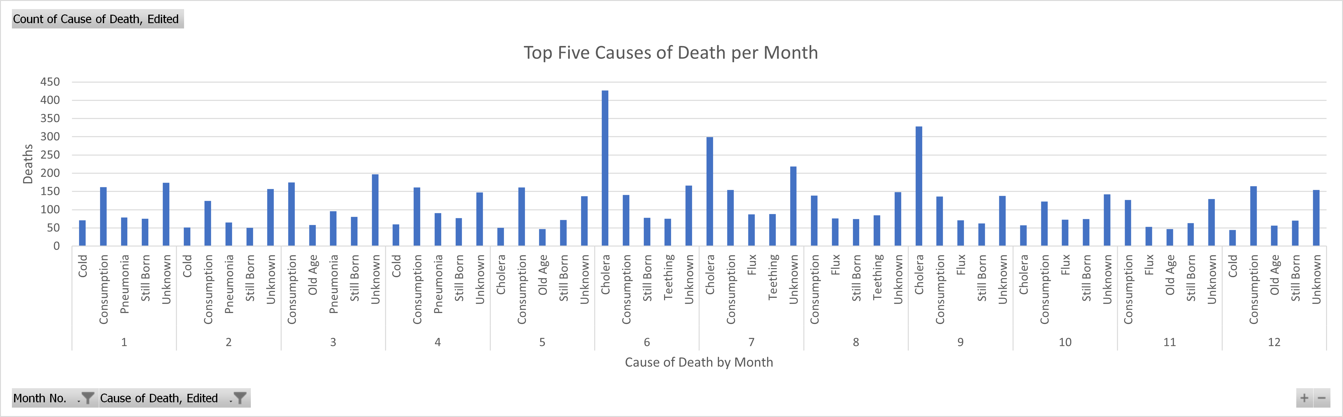
Top 5 Causes of Death by Month

Slide 4
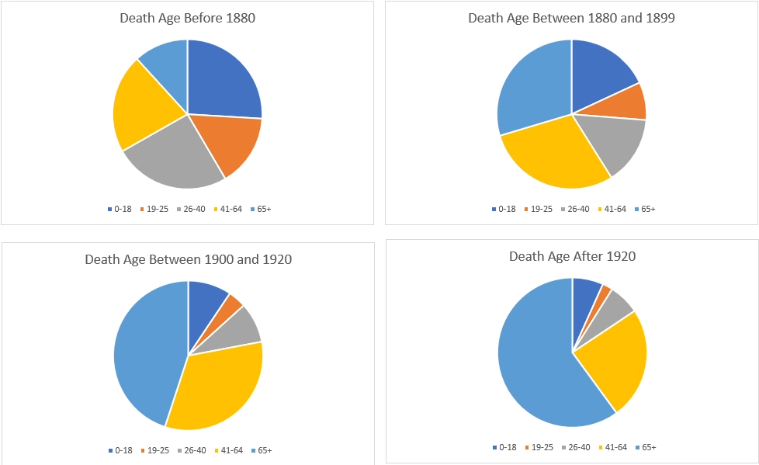
Death Ages Over Time

